Slide 1
Can I build a model to accurately predict the origin of a specific post on Reddit.

Slide 2
What did I choose to look at it
“Tales from Your Server” subreddit, includes stories from employees in the food service industry.
“Tales from the Front Desk” subreddit, includes stories from employees in the lodging industry.

Slide 3
How did I prepare the data?
I used the Pushshift API to scrape the data from the reddit website.
Built a function to pull the posts and organize them into a dataframe with only relevant information
Removed non alphanumeric characters
Combined features

Slide 4
Modeling
For the purposes of the project I ran several models including Logistic Regression, K-Nearest-Neighbors, Naïve Bayes, and Random Forests.
For all of these models I conducted gridsearch and count vectorize to turn the strings into and readable data for the models.
Using various parameters I tuned each model to find the best possible outcome.

Slide 5
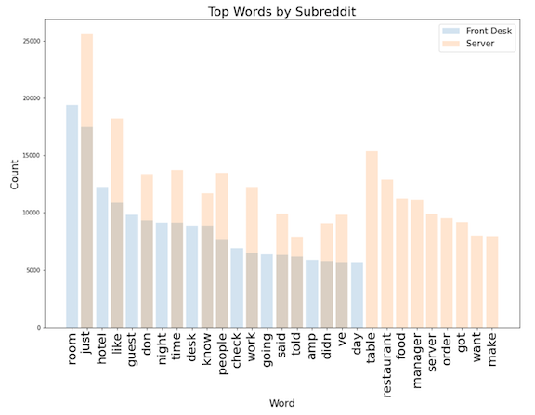
Are the Models to Good?
Realizing the models might be to good I conducted some EDA to find the top words and unique words for each subreddit.

Slide 6
KNN Model produced the least suitable accuracy and was promptly abandoned.
Logistic Regression Models produced some of the most consistent scores across various instances of tuning.
Naïve Bayes produced similar results to Logistic Regression.
Random Forest was able to produce similar results as Logistic Regression on much smaller datasets.

Slide 7
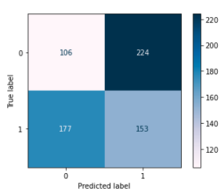
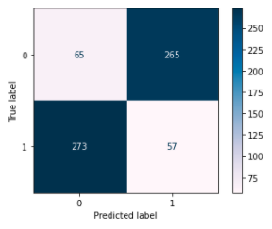
To Lemmatize or Not to Lemmatize
Rest
Rest
Hotel
Hotel
Rest
Hotel
Rest
Hotel
When conducting a model using a lemmatized dataset, the results for the Logistic Regression and K Nearest Neighbors models were both unsuitable. The scores were 19% and 39% respectively. After receiving theses scores it was decided not to proceed with further modeling on lemmatized words.

Slide 8
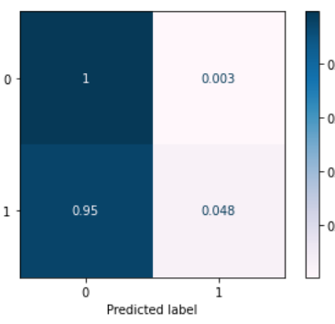
Interesting Anomaly
Rest
During the tuning of some of the models, I was able to increase the accuracy for the restaurant subreddit to 100%, however at the same time the accuracy for the Hotel subreddit would plummet. To the left you will see one example o this.
Hotel
Rest
Hotel

Slide 9
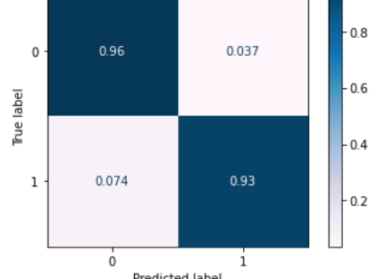
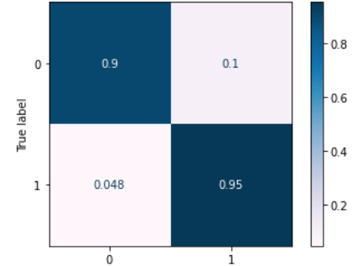
Best Models
Rest
Rest
Hotel
Hotel
Rest
Hotel
Rest
Hotel
LR MODEL, 95.02% Accurate
RF Model, 92.52% Accurate

Slide 10
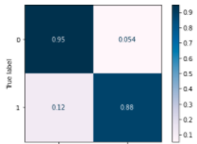
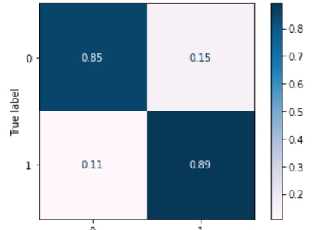
Best Models with Unique Words Removed
Rest
Rest
Hotel
Hotel
Rest
Hotel
Rest
Hotel
LR MODEL, 92.24% Accurate
RF Model, 87.12% Accurate

Slide 11
Conclusions
This shows that we can accurately predict the correct subreddit with less data collection, and thus using less resources. This will also allow for more time to dedicate to tuning the model for the best outcomes, as we have less data to collect and clean.
Next steps are to adapt these techniques to the larger project of sentiment analysis for the hotels and restaurants.

Slide 12
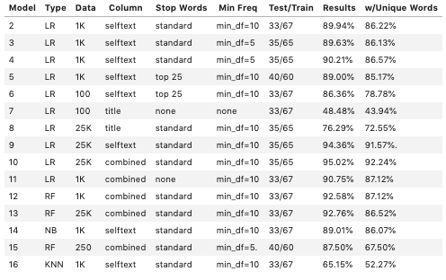
APPENDIX A

Slide 13
Questions and Answers
Chris Johnson
GA DSI720 – Project 3

